Slide 1
Using the Layout Editor
Notes:
Schedule: Timing Topic
20 minutes Lecture
20 minutes Total

Slide 2
Objectives
After completing this lesson, you should be able to do the following:
  Control the position and size of objects in a layout
  Add lines and geometric shapes
  Define the colors and fonts used for text
  Color the body and boundaries of objects
  Import images onto the layout
Notes:
Overview
Introduction
In this lesson, you learn the graphical features of the Layout Editor of Oracle Forms Developer. This will help you control the visual arrangement and appearance of objects in your applications.
Objectives
After completing this lesson, you should be able to do the following:
Control the position and size of objects in a layout
Add lines and geometric shapes
Define the colors and fonts used for text
Color the body and boundaries of objects
Import images onto the layout

Slide 3
Using the Layout Editor
Common features:
  Moving and resizing objects and text
  Defining colors and fonts
  Importing and manipulating images and drawings
  Creating geometric lines and shapes
  Layout surface: Forms canvas view
Notes:
Why Use the Layout Editor?
The Layout Editor is a graphical tool for defining the arrangement and appearance of visual objects. The Layout Editor opens windows in Forms Builder to present the surfaces on which you can arrange objects.
The following are functions of the Layout Editor:
Moving objects to new positions in the layout and aligning them with each other
Resizing objects and text
Defining the colors of text and visual objects
Creating lines, boxes, and other geometric shapes
Importing and manipulating images on the layout
Changing the font style and weight of text
Accessing the properties of objects that you see in the layout
You can use the Layout Editor to control the visual layout on canvas views in Oracle Forms Developer. A canvas is the surface on which you arrange a form’s objects. Its view is the portion of that canvas that is initially visible in a window at run time. You can also see stacked or tabbed canvas views in the Layout Editor; their views might overlay others in the same window. You can also display stacked views in the Layout Editor.

Slide 4
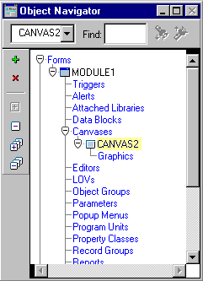
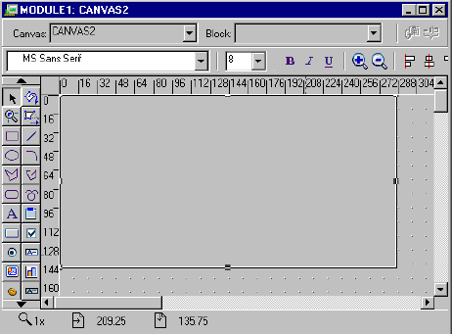
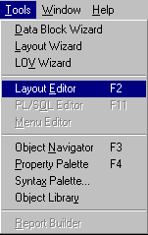
Invoking the Layout Editor
Notes:
How to Access the Layout Editor
You can invoke the Layout Editor from either the Builder menus or the Object Navigator. This applies whether you are doing so for the first time in a session or at a later stage. If you have minimized an existing Layout Editor window, you can also reacquire it in the way that you would any window.
Opening from the Object Navigator
Double-click a canvas view icon in a form hierarchy.
Opening from the Builder Menus
Make sure that you have a context for a form by selecting the appropriate objects in the Navigator.
Select Tools > Layout Editor from the Builder menu.

Slide 5
Notes:
How to Access the Layout Editor (continued)
In Forms, you can open several Layout Editor windows—one for each canvas view. Make sure that you have the canvas that you want.
Closing the Layout Editor
You can close or minimize the Layout Editor window or windows as you would any window.
Instructor Note
Demonstration:
Accessing through the Tools menu
Access through the Navigator
Closing and minimizing the Layout Editor window
Reopening the Layout Editor

Slide 6
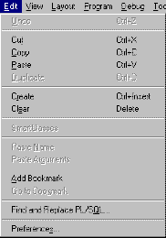
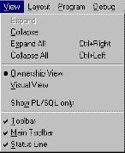
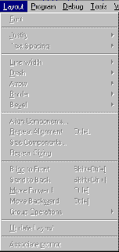
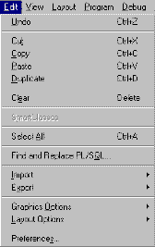
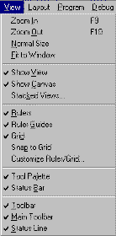
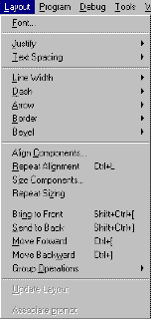
Layout Editor: Components
1
Notes:
Components of the Layout Editor
Common components of the Layout Editor are:
1. Menu facilities
While the Layout Editor window is active, the options available on the Edit, View, and Layout Builder menus expand. The new choices are submenus for controlling the Layout Editor.
The slide above shows the Edit, View, and Layout menus. The top screenshots show what these menus look like when the Object Navigator is active, while those on the bottom show the expanded choices when the Layout Editor is active.

Slide 7
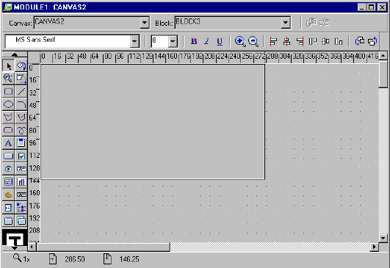
Layout Editor: Components
2
3
4
5
8
7
6
9
Notes:
Components of the Layout Editor (continued)
Common components of the Layout Editor are: (continued)
2. Title bar: Displays the name of the current form, the name of the canvas being edited, and the name of the current block. When you create an item by drawing it on a canvas in the Layout Editor, Forms Builder assigns the item to the current block, as indicated by Layout Editor block context. You can change Layout Editor block context using the Block poplist on the title bar.
3. Horizontal toolbar: Contains buttons that enable you to update the layout or associate text with an item prompt.
4. Style bar: Appears under the title bar and horizontal toolbar. The style bar contains buttons that are a subset of the View and Layout menus.
5. Vertical toolbar: Contains the tools for creating and modifying objects on the layout. Note that some tools in the palette may be hidden if you have reduced the size of the Layout Editor window. If so, scroll buttons appear on the vertical toolbar.
There are three types of tools:
Graphics tools for creating and modifying lines and shapes
Tools for creating specific types of items
Manipulation tools for controlling color and patterns

Slide 8
Notes:
Components of the Layout Editor (continued)
Common components of the Layout Editor are: (continued)
6. Rulers and ruler guides
Rulers are horizontal and vertical markers to aid alignment; they appear at the top and side of the layout region. You can switch these off or have their units altered, as required. Drag ruler guides from the rulers across the layout region to mark positions in the layout.
7. Layout/Painting region: The main area where you can place and manipulate objects. A grid pattern can be displayed in this area to aid alignment of objects. You can switch off or rescale this grid if required (the grid is hidden in the canvas portion of the layout/painting region if the View > Show Canvas option is switched on).
8. Canvas: The portion of the layout/painting area where objects must be placed in order for the form module to successfully compile. If objects are outside this area upon compilation, you will receive an error.
9. Status line: Appears at the bottom of the window. It shows you the mouse position and drag distance (when moving objects) and the current magnification level.

Slide 9

Tool Palette
1
8
2
9
3
10
4
11
5
12
6
13
7
Notes:
Creating and Modifying Objects in the Layout
You can perform actions in the Layout Editor by selecting from the vertical toolbar and the Builder menus and by controlling objects directly in the layout region.
Creating Lines and Shapes
Create geometric lines and shapes by selecting from the graphics tools in the vertical toolbar. These include: Rectangles/squares, ellipses/circles, polygons and polylines, lines and arcs, and the freehand tool.

Slide 10
Notes:
Creating and Modifying Objects in the Layout (continued)
Creating a New Line or Shape
1. Select the required graphic tool from the vertical toolbar with a mouse click. This selects the tool for a single operation on the layout (a double-click causes the tool to remain active for subsequent operations).
2. Position the mouse at the start point for the new object in the layout, and then click-and-drag to the required size and shape.
3. Release the mouse button.
Notice that the object remains selected after this procedure (selection handles appear on its boundaries) until you deselect it by clicking elsewhere.
Note: You can produce constrained shapes (for example, a circle instead of an ellipse) by pressing the [Shift] key during step 2.
Creating Text
The Text tool (T) lets you open a Boilerplate Text object on the layout. You can type one or more lines of text into this object while it is selected with the Text tool. Uses of text objects vary according to the Oracle Developer tool in which you create them.
Instructor Note
Show in the Layout Editor:
Creating a line and at least one other shape
Using the Freehand tool
Creating a circle or square using Constrained mode
Creating boilerplate text, with text over multiple lines
Double-clicking the palette tool to retain selection

Slide 11
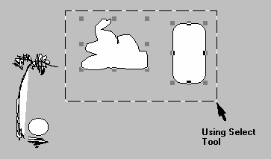
Selecting Objects
Notes:
Selecting Objects for Modification
The default tool in the vertical toolbar is Select, with which you can select and move objects. If the Select tool is active, you can select one or more objects on the layout to move or modify.
To select one object, do one of the following:
Click the object with the mouse
Draw a bounding box around it
If the object is small or narrow, it is sometimes easier to use the second method. Also, an object may be transparent (No Fill), which can present a similar problem where it has no center region to select.
It is convenient to select several objects, so that an operation can be performed on them simultaneously.
To select several objects together, do one of the following:
Hold down the [Shift] key and then click each object to be selected
Draw a bounding box around the objects (providing the objects are adjacent to each other)

Slide 12
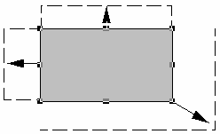
Manipulating Objects
Expand/contract
in one direction
Expand/contract
diagonally
Notes:
Changing the Size or Ratio
When an object is selected, two types of selection handles are visible:
Corner handles: Position the mouse on one of these to change the size or ratio of the object diagonally.
Midpoint handles: Position the mouse on one of these to change the size or ratio in a horizontal or vertical direction.
Note: By holding down the [Shift] key, you can resize an object without changing its ratios. This means that squares remain as squares, and images do not become distorted when resized.

Slide 13
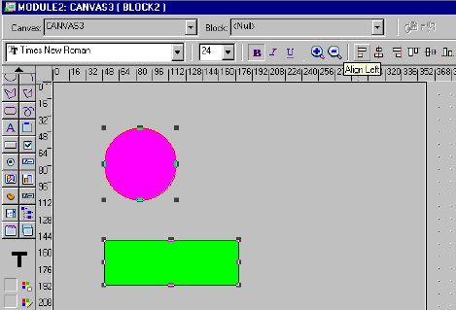
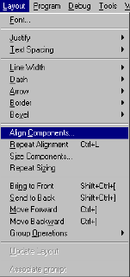
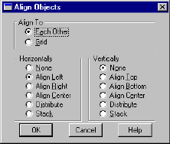
Moving, Aligning, and Overlapping
Notes:
Moving and Aligning Objects
When one or more objects are selected in the layout, you can:
Move them to a new location: Do this by dragging to the required position and releasing the mouse button. You can use the grid and ruler lines to help you position them properly.
Align the objects with each other: Objects can be aligned with the leftmost, rightmost, highest, or lowest object selected. They can also be centered and aligned with the grid. You can do this using the Alignment feature in the Layout menu:
Select Layout > Align Components, and then set the options required in the Align Objects dialog box. You can also use the Align icons in the horizontal toolbar.
A Note on Grid-Snap Alignment: You can ensure that all objects that you move align with snap points that are defined on the grid. To activate these, select
View > Snap to Grid from the menu. You can also use the View options to change the grid-snap spacing and units.
Note: If you position an object using one grid-snap spacing, and then try to position other objects under different settings, it may prove difficult to align them with each other. Try to stick to the same snap units, if you use grid-snap at all.

Slide 14
Notes:
Moving and Aligning Objects (continued)
Overlapping Objects
You can position objects on top of each other. If they are transparent, then one object can be seen through another (this is explained in detail later in this lesson).
Change the stacking order of overlapping objects by selecting the object to move and then choosing the following as required, from the Layout menu:
Bring to Front
Send to Back
Move Forward
Move Backward
Instructor Note
Create your own objects to show the following:
Selecting multiple objects by pressing and holding [Shift] while you click the objects
Selecting by a bounding box
Losing the association after you deselect
Expanding and contracting in different directions, pointing out handles
Moving an object on the layout
Lining up several objects using the Align Objects dialog box
Moving objects while grid-snap is on
How grid and grid-snap can be turned on/off and how units can be altered (pointing out the warning opposite)
Overlapping some objects and changing layering through the Layout menu

Slide 15
Groups in the Layout
  Groups allow several objects to be repeatedly treated as one.
  Groups can be colored, moved, or resized.
  Tool-specific operations exist for groups.
  Groups have a single set of selection handles.
  Members can be added or removed.
Notes:
Manipulating Objects As a Group
Sometimes, you want to group objects together in the layout so that they behave as a single object.
Placing Objects into a Group
1. Select the objects in the layout that are to be grouped together.
2. Select Layout > Group Operations > Group from the menu.
You will notice there is now a single set of selection handles for the group, which you can treat as a single object whenever you select a member within it. The Layout menu also gives you options to add and remove members. Resizing, moving, coloring, and other operations will now apply to the group.
Manipulating Individual Group Members
To manipulate group members individually, select the group and then click the individual member. You can use options in the Group Operations menu to remove objects from the group or to reselect the parent group.

Slide 16
Notes:
Manipulating Objects As a Group (continued)
Other Tools for Manipulating Objects
Rotate: You can rotate a line or shape through an angle, using the tool’s selection handles.
Reshape: You can change size/ratio of a shape that has been rotated or change the sweep angle of an arc. You can also reshape a polygon or polyline.
Magnify: You can increase magnification when you click at a desired zoom position on the layout region. Pressing and holding [Shift] while you click reduces magnification.
Note: You can undo your previous action in the current Layout Editor session by selecting Edit > Undo from the menu.
Instructor Note
Create your own objects to do the following:
Place some objects into a group, and then show how they can be manipulated as one. Point out the single set of handles.
Point out or mention the other grouping options (Group Operations menu).
Demonstrate zooming in/out using the Magnify tool.
Show Undo/Redo of a Layout Editor operation from the Edit menu.

Slide 17
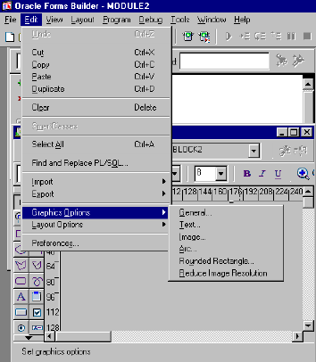
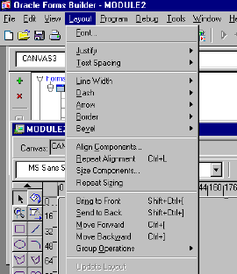
Edit and Layout Menus
Notes:
Formatting Objects in the Layout
The Builder’s Layout and Edit menus provide a variety of facilities for changing the style and appearance of objects in the layout. These include:
Font sizes and styles
Spacing in lines of text
Alignment of text in a text object
Line thickness and dashing of lines
Bevel (3D) effects on objects
General drawing options (for example, style of curves and corners)
Whichever formatting option you intend to use, first select the objects that you intend to change on the layout, and then choose the necessary option from the menu.
Some of the format options are available from the style bar.

Slide 18
Notes:
Formatting Objects in the Layout (continued)
Changing Fonts on Textual Objects
There are a number of ways to change the font characteristics of textual objects. The common steps provided by the Layout Editor are:
Select the objects in the layout whose content text you want to change (these may be boilerplate text objects and other textual object types).
Select the font style and size that you require from the style bar or select Layout from the Builder menu, and the select the font style and size that you require.
Note: In Microsoft Windows, selecting Font from the menu opens the standard Windows Font dialog. In other GUI environments, the font choices may appear in the Layout menu itself. Font settings are ignored if the application is run in character mode.
Instructor Note
Provide an overview of the Layout and Edit menu options and demonstrate:
Changing the line thickness of a shape
Producing bevel effects on this shape
Changing the font size and style of boilerplate text

Slide 19
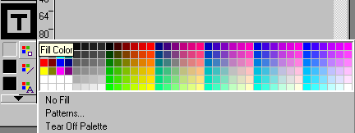
Color and Pattern Tools
1
2
3
4
Notes:
Coloring Objects and Text
The vertical toolbar contains tools for coloring objects. These are:
1. Sample Window: Shows the fill, line, and text color of the currently selected object. If no object is selected, shows the settings for new objects.
2. Fill Color: Use this tool to define the colors and pattern for an object’s body.
3. Line Color: Use this tool to define the color of a line or the boundary line around an object.
4. Text Color: Use this tool to choose the color for the text.
Coloring Objects
You can separately color the fill area (body) of an object and its boundary line (a line object has no body).
Coloring a Line
With the desired layout objects selected, click the Line Color tool. The color palette opens.
Select the color for lines and bounding lines from this color palette. Select No Line at the bottom of this window to remove the objects’ boundary lines.
Note: If you set both No Fill and No Line, the affected objects become invisible.

Slide 20
Notes:
Coloring Objects and Text (continued)
Coloring an Area
1. Select the objects whose color you want to change.
2. Select the Fill Color tool. The color palette appears.
If you want the objects to become transparent, select No Fill at the bottom of the color palette window.
3. Select a color from the color palette. If you want the fill area to be patterned instead of plain, then select Patterns from the bottom of the color palette, and follow the next step.
4. If you select Patterns, another window appears with patterns for you to choose. Select one. You can define separate colors for the two shades of the pattern by selecting the pattern color buttons at the bottom of the Fill Pattern palette; each button opens a further color palette.
Coloring Text
1. Select the textual objects whose color you want to change in the layout.
2. Select the Text Color tool. The color palette appears, showing the available colors.
3. Select a color from the color palette (click the appropriate square).
4. Notice that the selected objects on the layout have adopted the chosen text color. Also, the sample area in the vertical toolbar shows a T with the selected color, and this color appears next to the Text Color tool. This indicates the current text color setting.
Altering the Color Palette
By selecting Edit > Layout Options > Color Palette from the menu, you can edit the color palette that is presented when selecting colors. This option is available only when the Builder option Color Palette Mode is set to Editable in the Preferences dialog (Edit > Preferences). Changes to the color palette are saved with the current module.
Note: Modifications to the color palette will not be apparent until you close the document and reopen it.
Instructor Note
Show the following:
Coloring the body of a shape
Changing the fill pattern and how elements of the pattern can be colored
Making an object transparent and how other objects can then be seen through it
Coloring lines and removing them completely
Coloring text
How color palettes can be torn off and repositioned
How color settings are retained in the Layout Editor
How to modify the color palette

Slide 21
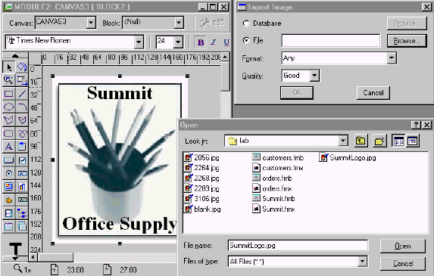
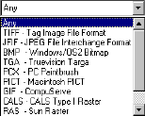
Importing Images
Notes:
Importing Images
Oracle Forms Developer allows both static and dynamic bit-mapped images to be integrated into the application. This section discusses how you can import static images—that is, those that are fixed on the layout. These might include:
Company logos
Photographs for inclusion in a report or display
Background artwork
You can import images onto the layout from either the file system or the database. Select Edit > Import > Image from the menus, and set the Import Image options:
File/Database radio buttons: Specify location from which to import
Filename: File to be imported (click Browse to locate file)
Format: Image format; choices are TIFF , JFIF (JPEG), BMP, TGA, PCX, PICT, GIF, CALS, RAS
Quality: Range from Excellent to Poor. There is a trade-off between image resolution and memory required.

Slide 22
Notes:
Importing Images and Drawings
Manipulating the Imported Image
When the imported image appears on the layout, you can move it or resize it like other objects on the layout. It is usually better to resize images in Constrained mode (while pressing the [Shift] key) so the image does not become distorted.
Instructor Note
Show how to import an image from the file system, pointing out the various file formats that are supported. Recommend using SummitLogo.jpg.
Show that boilerplate images can be moved and resized on the layout.

Slide 23
Summary
  You can create objects by:
    Choosing a palette tool
    Clicking and dragging on a layout region
  There are color palette tools for fill area, lines, and text.
  View, Edit, and Layout menus display additional options for layout.
  Objects can be grouped for operations.
  You can import images by using Edit > Import.
Notes:
Summary
You can create objects by:
Choosing the correct toolbar tool
Clicking and dragging the layout region
There are color palette tools for fill area, lines, and text.
View, Edit, and Layout menus display additional options while you are in the Layout Editor.
You can group objects for operations.
You can import images by selecting Edit > Import.

